Slide 1
Teacher's well-being and mental health
Liina Adov
Junior Research Fellow University of Tartu, Department of Education
Psychologist/Therapist Katriito

Slide 2
Teachers’ professional standards by Estonian Qualifications Authority
B.2.4 Reflection and professional self-development
3) monitors, evaluates, and values ones physical, mental, and emotional health, takes action in keeping the balance between these, optimizes the time and energy expenditure…..

Slide 3
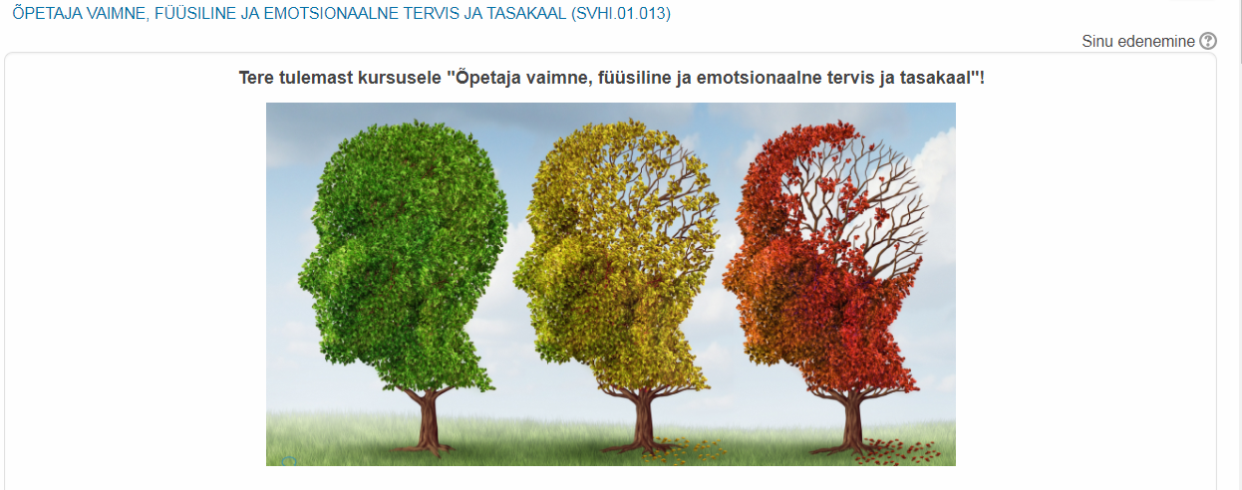
Elective course for student teachers
„Teachers’ physical, mental, and emotional health and balance between these“

Slide 4
„In Estonia we don’t speak much about teachers’ stress and burnout, however, the presence of burnt out teachers’ in every school, shows us that this matter hasn’t got enough attention from the government.“
Kärt Käsel Association of Estonian School Psychologists

Slide 5
Teachers as high risk group
Low controll
Emotional demandingness
Work with people
UK example - 19,4% moderate to severe depression symptoms
Australian example - 26% high risk group for psychological problems
Garrick, A., Winwood, P. C., Mak, A. S., Cathcart, S., Bakker, A. B., & Lushington, K. (2014). Prevalence and organisational factors of psychological injury among Australian school teachers. Australasian Journal of Organisational Psychology, 7. https://doi.org/10.1017/orp.2014.5
Kidger, J., Brockman, R., Tilling, K., Campbell, R., Ford, T., Araya, R., … Gunnell, D. (2016). Teachers’ wellbeing and depressive symptoms, and associated risk factors: A large cross sectional study in English secondary schools. Journal of Affective Disorders, 192, 76–82. https://doi.org/10.1016/j.jad.2015.11.054
Wieclaw, J., Agerbo, E., Mortensen, P. B., Burr, H., Tuchsen, F., & Bonde, J. P. (2008). Psychosocial working conditions and the risk of depression and anxiety disorders in the Danish workforce. BMC Public Health, 8, 280-288.

Slide 6
Teachers influence on students
Kinman, Wray, & Strange (2011) bring out that
“teachers who reported more emotional labour were not only more emotionally exhausted and less satisfied with their work, they were also more likely to depersonalise their pupils.”
Kinman, G., Wray, S., & Strange, C. (2011). Emotional labour, burnout and job satisfaction in UK teachers: The role of workplace social support. Educational Psychology, 31(7), 843-856.

Slide 7
Motivation
Autonomy, relatedness, precieved competence, self-efficacy
Indicators of mental health (anxiety, sleep deprivation etc.)
Ebmeier, 2003
Deci, Ryan, Gagné, Leone, Usunov, & Kornazheva, 2001
Job satisfaction
Wieclaw jt, 2008; Brien, Hass, & Savoie, 2012; Kidger, J., et al., 2016
Experience with covision and supervision
Kidger, J., et al., 2016
Gibson, Grey, & Hastings, 2009, Geeraerts jt, 2015
Stress management
Yamada, Hagihara, & Nobutomo, 2008
Tang, Au, Schwarzer, & Schmitz,2001
Kidger, J., et al., 2016
Burnout
Preceived stress

Slide 8
Data collection
Emotional State Questionnaire (EEK-2; Ööpik, Aluoja, Kalda, & Maaroos, 2006; Aluoja, Shlik, Vasar, Luuk, & Leinsalu, 1999)
Teachers’ Sense of Efficacy Scale (Tschannen-Moran & Hoy, 2001)
The Basic Need Satisfaction at Work Scale (Deci, Ryan, Gagné, Leone, Usunov, & Kornazheva, 2001; Ilardi, Leone, Kasser, & Ryan, 1993; Kasser, Davey, & Ryan, 1992).
Job satisfaction (Caprara, Barbaranelli, Borgogni, & Steca, 2003)
Perceived Stress Scale (Kallasmaa & Pulver, 2000)
Coping with Stress (Carver, C. S., 1997)

Slide 9
Longitudinal study
1st wave March/Aprill 2017 All schools in Estonia
2nd wave November 2017 All schools + teachers from 1st wave
3rd wave March 2017 Teachers from 1st and 2nd wave

Slide 10
Preliminary results
1st wave
329 teachers
1/3 of teachers > anxiety and depression symptoms
↑ stress = ↑ anxiety/dep.sym.
↑self-efficacy =↓ anxiety/dep.
Formal covision(peer group mentoring) - ↓ anxiety/dep
2nd wave
236 teachers
66% ↑ Asthenia
36 – 40% ↑ anxiety/dep. sym.
38% ↑ problems with sleep

Slide 11

Thank you! Aitäh! Hvala!
liina.adov@ut.ee

